Slide 1
Customer Segmentation
In
Telecom Industry
Modelling and implementing For Skynet
By: Mohamed and Oskar

Slide 2
Today’s agenda
Project Recap
Problem
Process
Challenges
Dashboard

Slide 3

Project Recap
Skynet is a Network Telco and Internet service Provider
Market leader in Fixed Broadband in Iran (in terms of Revenue)
Network :
Owned RAN: TDD & Owned Fiber Optics
Home Services:
Internet
Cloud Video surveillance
Enterprise Services:
All range of Business connectivity
Cloud based services

Slide 4
Problem
Company is doing mass marketing activities to increase the revenue from the customer base
Target:
To customize Marketing promotions and offerings based on customer’s demands
Prerequisites:
Customer Profiling (static and demographic data)
Customer segmentation (behavioral analytics)
CRM Automation
Ready
Needs to be Done!
Notes:
Why Customer Segmentation?
- Highlight the value of treating customers differently based on their behaviors and preferences.
- Mention benefits: Increased engagement, improved campaign effectiveness, and higher returns on investment
- one size does not fit all

Slide 5
Customer Segmentation
improves your overall ROI by reducing waste in advertising
creating the feeling that you understand your customers, their interests, and concerns
Increase consumer engagement.
Increase consumer satisfaction and loyalty.
Notes:
https://www.marketingevolution.com/marketing-essentials/customer-segmentation-models

Slide 6
What are the Types of Customer Segmentation Models?
Product-Based Segmentation
Usage-Based Segmentation
Life Cycle Stage Segmentation
RFM Segmentation

Slide 7

Project Scope
Customer base (Home service): 400,000
Data sets:
Sales transactions (6 months)
about 3 Million Records
Products and Packages
about 200 rows

Slide 8
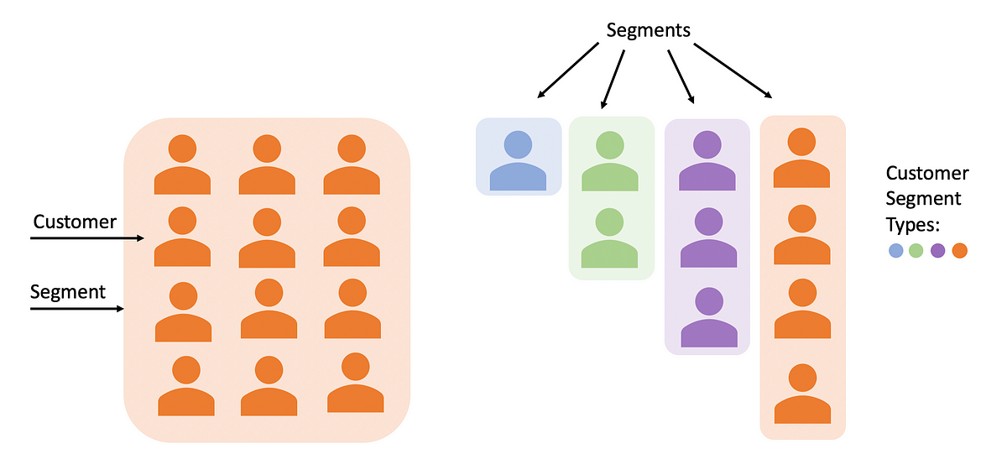
Process
Company and Context Understanding
Data Exploration and cleaning
Segmentation model literature review
Model implementation
Operational Dashboard design

Slide 9
Process
5
Validation
1
Business Understanding
3
Data Preprocessing
(EDA)
2
Data
Exploration and Cleaning
4
Data Processing
(Model)

Slide 10
Model
RFM Model :
Recency How recent was the customer's last purchase?
Frequency How often did this customer make a purchase in a given period?
Monetary How much money did the customer spend in a given period?

Slide 11
Did that model works ? why ?

Slide 12
Challenges
RFM model does not fulfil stakeholder demands requirements
Matching clustering results with real marketing demands
Defining and calculating marketing KPIs (Churn Rate - Newcomers)
Designing final Dashboard showing the changes done on main KPI’s
Notes:
Different types rate plan and extra gid
72 different products “Duration _ Volume”
Data limitation (6 months)

Slide 13
Limitations
6 month data set
Diversity of products duration (one Year packages - 6 Months packages)

Slide 14
Process
Marketing Manager Tips
5
Validation
1
Business Understanding
3
Data Preprocessing
(EDA)
2
Data
Exploration and Cleaning
4
Data Processing
(Model)

Slide 15
Segmentation model
Recency is not a time passed from the last transaction date but it is a time passed from expiration of the last (Rate Plan) transaction.
Frequency is the number of Rate Plan transactions not all transactions
ARPU is Monthly AVERAGE Revenue of each customer for active month
ACPU is Monthly Average consumption - Traffic - used by each Customer

Slide 16
Results
Notes:
Percentage of active , edg and inactive users pie chart
How many segment we achieved ?
bar chart showing segment and number of customers in each one
in a table show the characteristics of each one of them.

Slide 17
Insights

Slide 18
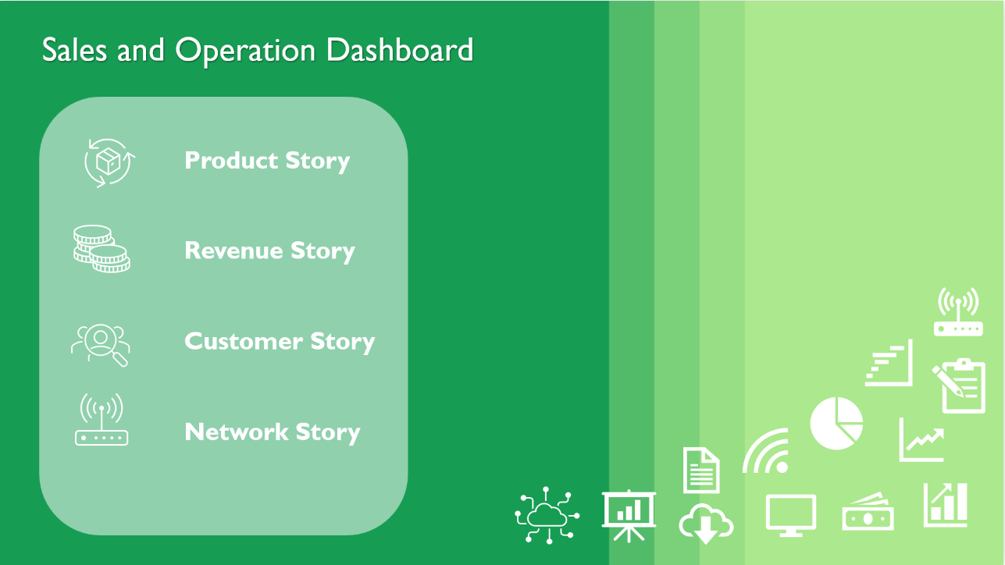

Slide 19
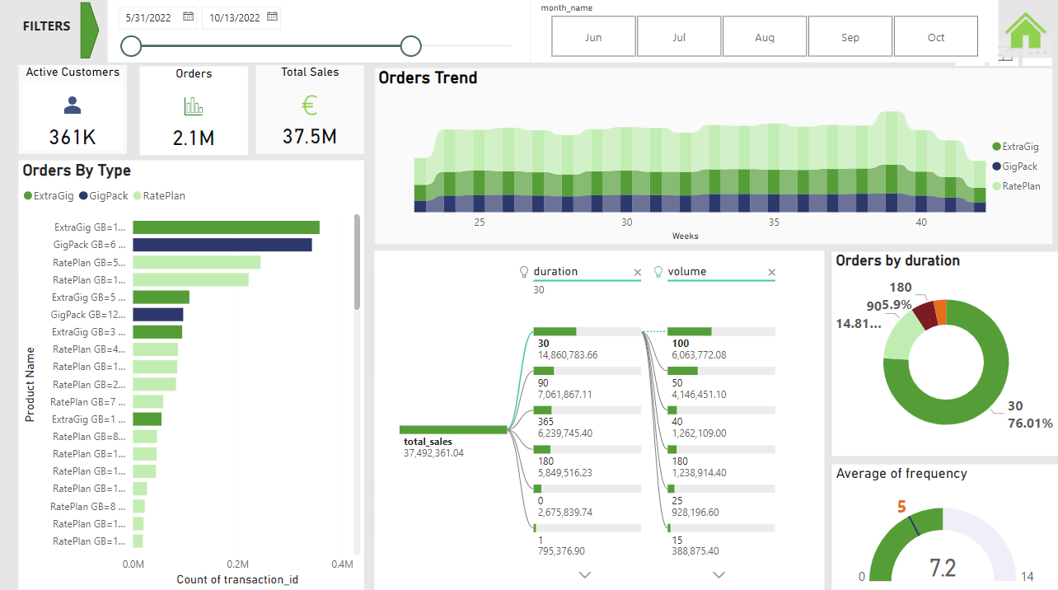

Slide 20
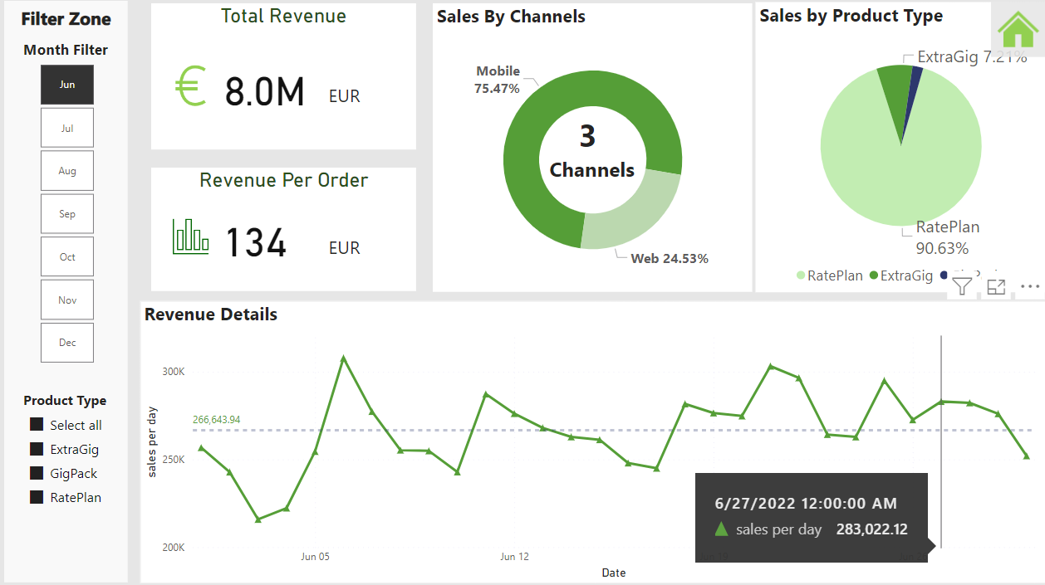

Slide 21
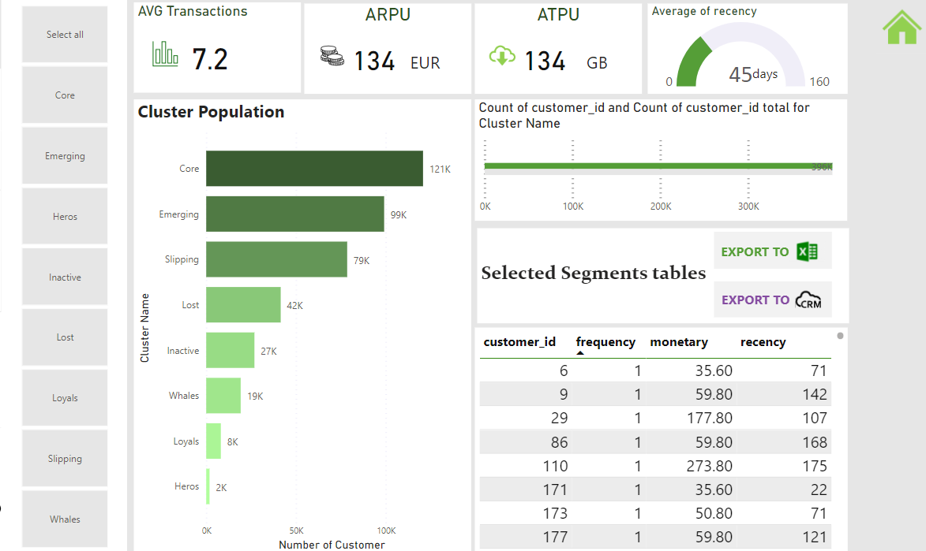

Slide 22
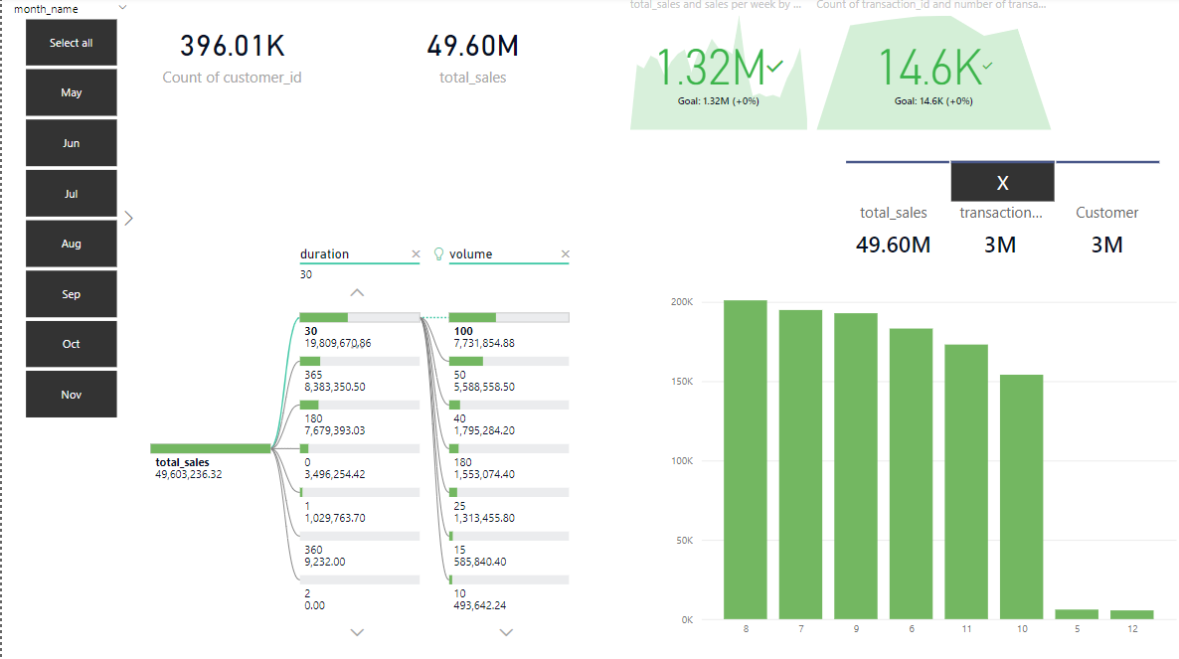
Sales performance Monitoring Dashboaord

Slide 23
Summary

Slide 24
Thank You !!
Feedback??

Slide 26
Minimum Viable Product

Slide 27
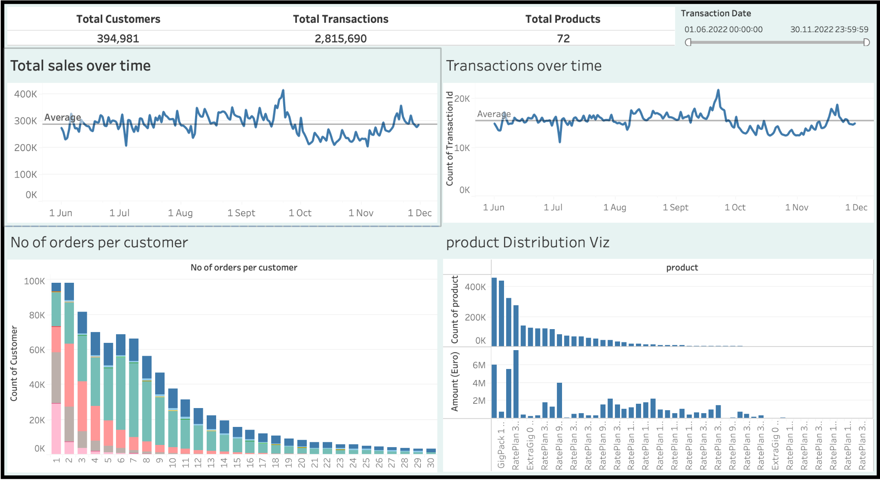
Sales performance Monitoring Dashboaord

Slide 28
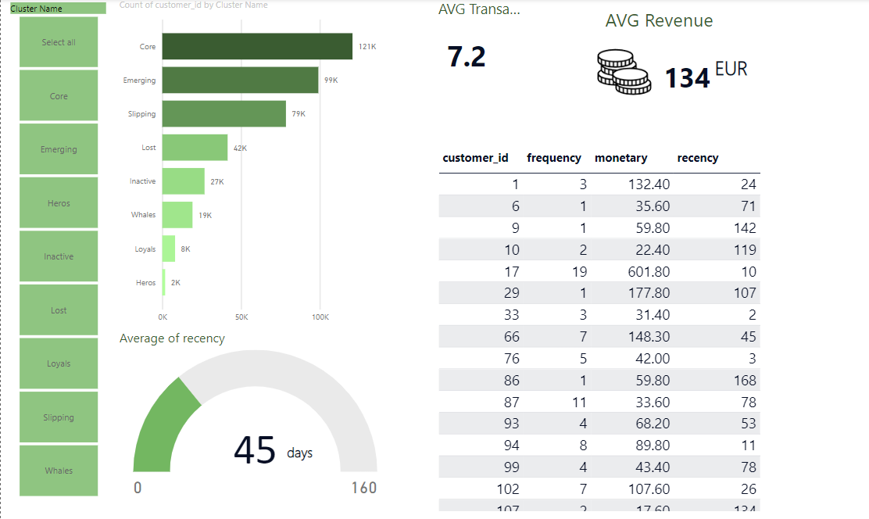
Customer Segments- sales Dashboard

Slide 30
CRM automation tools
No idea Yet??????????????????
But we Know they are using Ms CRM as part of their BSS

Slide 31

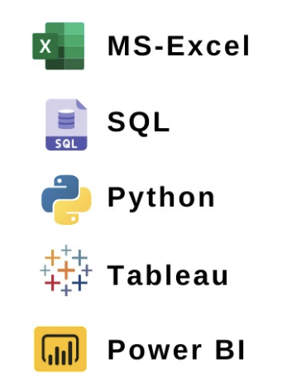
Technologies/Tools
Data cleaning and Preparation:
VScode
Python
Data Storage and query:
Azure Postgres Database
Data Visualization
Tableau
Power BI
Project planning
Miro/Kanban
tool Development:
????????

